Slide 1


SMART INDIA HACKATHON 2026
Problem Statement ID – SIH26043
Problem Statement Title – A Digital Platform to Crowdsource Societal Challenges and Facilitate Collaborative Problem Solving through
Universities and Industry Partnerships
Theme – Smart Education
PS Category – Software
Team ID – IT012
Team Name – THE NEXUS
PROPOSED SOLUTION: SAMAJ SETU AI
AI-Powered Societal Innovation & Collaboration Portal

Slide 2
SAMAJ
THE NEXUS
A single digital platform connecting Citizens, Government, Universities & Industry.
Citizens can report real-world problems with photos/videos and location.
AI to analyze and categorize problems, remove duplicates and identify priority problems.
AI identifies relevant universities with experts and resources.
Universities can assemble student and faculty teams to develop solutions.
Industry provides mentoring, funding, technology and pilot support.
Tracks the entire journey:
Problem → Team → Solution → Prototype → Implementation → Social Impact
Innovation :
AI-powered Problem-to-Solution matching Ecosystem
Converts scattered community problems into organized, collaborative and measurable solutions
Unique Features:
AI categorization → Duplicate detection → Smart university matching → Multi-stakeholder collaboration → Real-time impact tracking

Slide 3
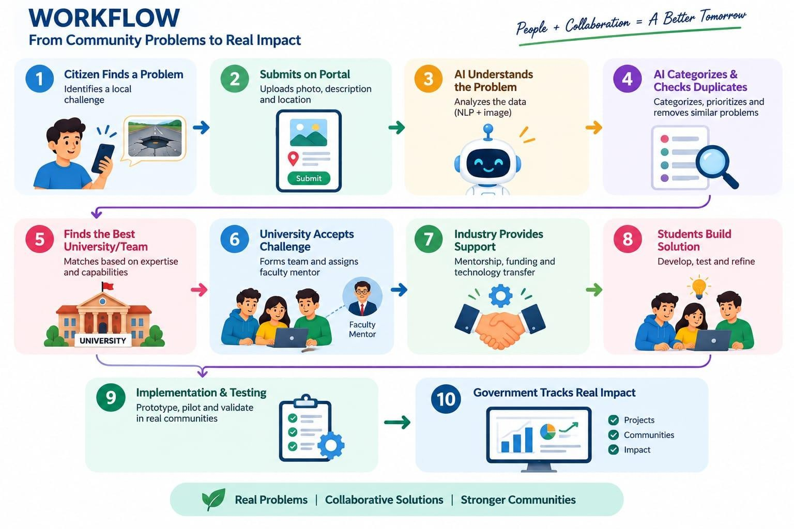
THE NEXUS
TECHNICAL APPROACH
TECHNOLOGY STACK:
Frontend: React.js / Flutter
Backend: Node.js / FastAPI
Database: PostgreSQL + MongoDB
AI: Python, NLP & Machine Learning
Maps: GIS & Maps API
Cloud: AWS / Firebase
Alerts: Firebase Cloud Messaging

Slide 4

FEASIBILITY AND VIABILITY
THE NEXUS
FEASIBILITY:
Proven Technology – Uses reliable Cloud, AI, Web & GIS technologies.
Easy to Use – Simple dashboards for Citizens, Universities, Industry & Government.
Highly Scalable – Can expand from District → State → National level.
CHALLENGES & MITIGATION:
Challenge | Solution
Duplicate / fake problems | AI duplicate detection + validation
Wrong university matching | AI capability-based matching
Low participation | Gamification + reminders
Project delays | Milestone tracking + alerts
Data privacy risks | Role-based access + encryption
VIABILITY ROADMAP:
MVP Portal → AI Engine → University Collaboration → Industry Integration → Analytics & Scale

Slide 5




IMPACT AND BENEFITS
THE NEXUS
STAKEHOLDER IMPACT:
Citizens – Easy problem reporting & transparent tracking
Universities & Students – Real-world projects, research & startup opportunities Industry & Startups – Innovation pipeline, CSR, mentoring & technology transfer Government – Data-driven decisions & transparent project monitoring
MEASURABLE OUTCOMES:
Challenges Submitted → Universities Engaged → Student Projects → Industry Collaboration → Pilots → Community Impact
3 Key Impacts:
SOCIAL: Faster resolution of community problems
ECONOMIC: Startups, patents & employment opportunities
INNOVATION: Stronger Government–University–Industry collaboration
Key Message:
“SAMAJ SETU AI turns citizens from passive beneficiaries into active contributors to innovation.”

Slide 6
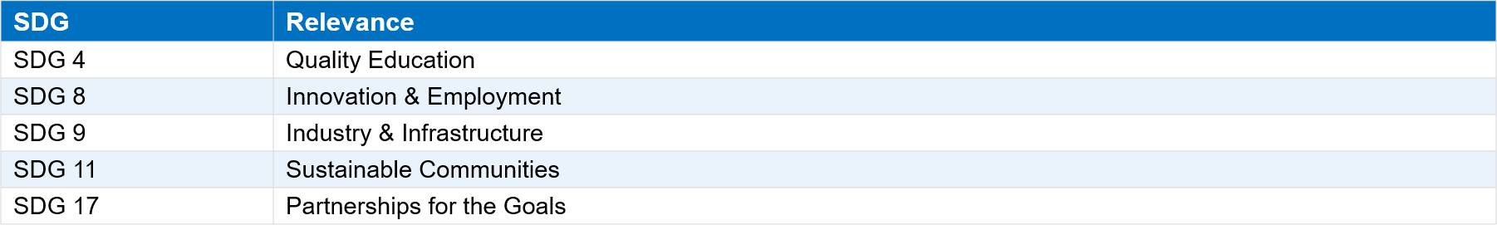
RESEARCH AND REFERENCES
THE NEXUS
RESEARCH BASIS:
AI & Machine Learning – Text classification, semantic similarity & smart recommendations.
GIS Technology – Maps and location-based identification of community problems.
Project Lifecycle Management – Tracks problems from submission → solution → implementation → impact.
In Government Alignment – Supports Digital India, Smart India Hackathon, AICTE Innovation & Atal Innovation Mission.
RELEVANT SUSTAINABLE DEVELOPMENT GOALS:
REFERENCES:
Smart India Hackathon (SIH) – sih.gov.in
AICTE – aicte-india.org
Atal Innovation Mission (AIM) – aim.gov.in
Digital India – digitalindia.gov.in
“Every societal problem is an opportunity for innovation”

